Slide 1


Accelerating Communication in Deep Learning Recommendation Model Training with Dual-Level Adaptive Lossy Compression
Hao Feng¹, Boyuan Zhang¹, Fanjiang Ye¹, Min Si², Ching-Hsiang Chu², Jiannan Tian¹, Chunxing Yin², Summer Deng², Yuchen Hao², Pavan Balaji², Tong Geng³, Dingwen Tao⁴
¹ Indiana University
² Meta
³ University of Rochester
⁴ SKLP, Institute of Computing Technology, Chinese Academy of Sciences
Notes:
Hello everyone, this is Hao Feng from Inidiana university. Today I would like to share our work xxxx coorperate with Meta and university of Rochester.

Slide 2
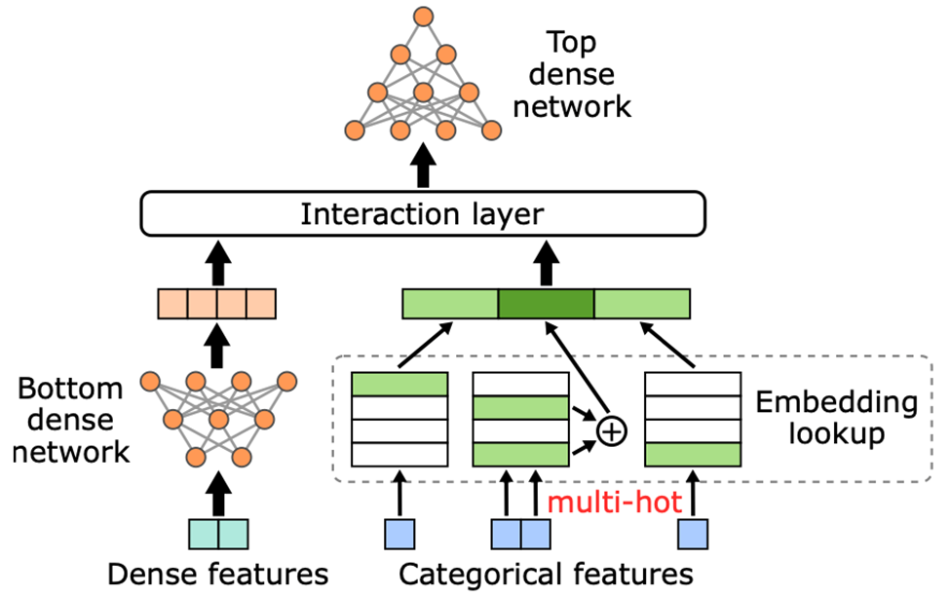
Introduction to DLRM
Deep Learning Recommendation Model (DLRM) is a recommendation model designed to make use of both categorical and numerical inputs.
Interaction layer learns features crosses by applying interaction on outputs from Bottom dense network and Embedding lookups.
DLRM GitHub Repo: https://github.com/facebookresearch/dlrm
Notes:
Before introducing our work, I would like to introduce some background about DLRM. DLRMs have been successfully implemented in various industry applications, including product recommendations system by Amazon [2], personalized advertising by Google [3], and e-commerce service by Alibaba. . [first paragraph]
The bottom dense network directly preprocesses dense input features. Meanwhile, category keys must first be resolved into their corresponding embedding vector representations by the embedding lookup tables. Results from both components are eventually fed into the interaction layer, which learns effective feature crosses and can exert a significant impact on model accuracy. Finally, a top dense network is applied to to extract/match complex patterns in the interaction layer's outputs, and produce the final prediction result.

Slide 3
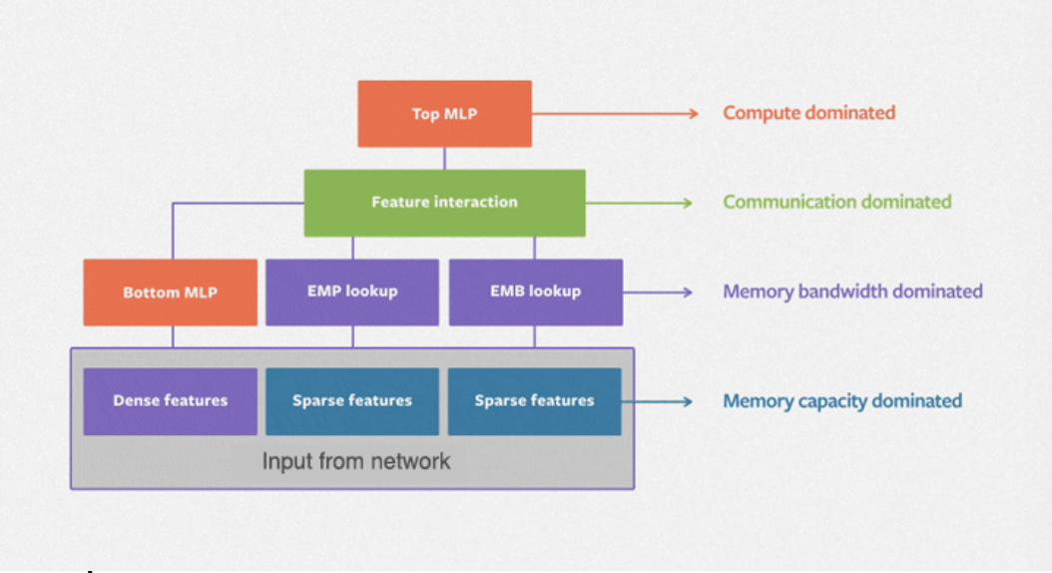
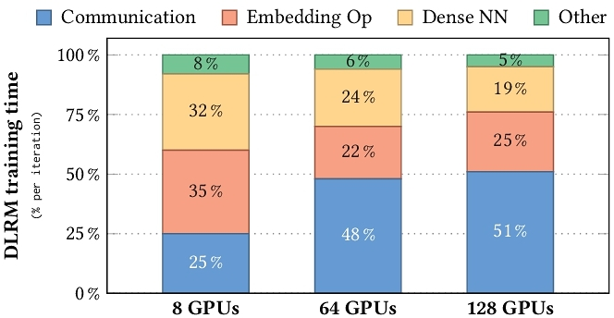
Bottleneck of DLRM
Due to large model / embedding (EMB) tables (cannot be stored on a single device), DLRM adopts model parallelism. It comes with all-to-all communication in forward and backward process of Interaction.
Notes:
Known the architecture of DLRM, we can move forward to see the bottleneck. The left figure shows the bottleneck of each components in DLRM training. Basiclly there are four kinds of domination, such as memory capacity domination for feature storage, and memory bandwidth bottleneck for EMB lookup due to irregular access. Let us focus on the communication dominated component “Feature interaction”. [Paragraph 1]. The right figure shows a profiling result. In this figure, we can see the communication takes the most time of training, introducing low GPU utilization. Thus, it is the bottleneck in DLRM trainig, especially on large scale training.

Slide 4
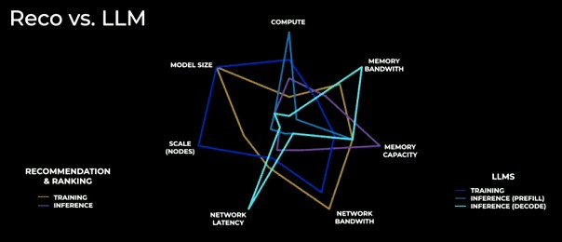
Bottleneck of DLRM
In industrial level DLRM model training, though the scale is not as large as LLM, the requirement of network bandwidth is even higher than LLM training, which has intensive communication.
Notes:
Here is a figure from Meta AI, showing the requirement and chanllenge for Recommandation model and LLM training from different aspects. The yellow line refers to recommendation model training. The dark blue line refers to LLM training. Comparing them we can find that the recommendation model training has even more intensive communication than LLM.
Known the bottleneck, let us move to solutions to overcome that.

Slide 5
Previous work on accelerating DLRM communication
Cache Embedding Vectors
This method proposed to cache some high frequently accessed embeddings, thus reduce the communication.
Cons: Unlike inference use fixed model, the model weight is changing in training. Introducing cache coherence challenge.
Tensor Train Decomposition
This method represents high-dimensional tensors in a compressed format by a series of small tensor called core tensors.
Cons: The hyper-parameter is hard to tune. Besides, matrices need to be re-initialized if tensor core’s size changes.
We reduce the data communication volume by compressing data directly.
Notes:
There are some work focus on accelerating dlrm training. I would like to share some of them.
First solution is cache mechanism, [paragraph 1].
Second solution is tensor train decomposition.
It is not designed for reducing communication data. However, it reduces communication data volume by reducing the need of number of GPUs. So it is a walk-around solution to reduce communication overhead.
I will introduce compression and especially lossy compression.

Slide 6
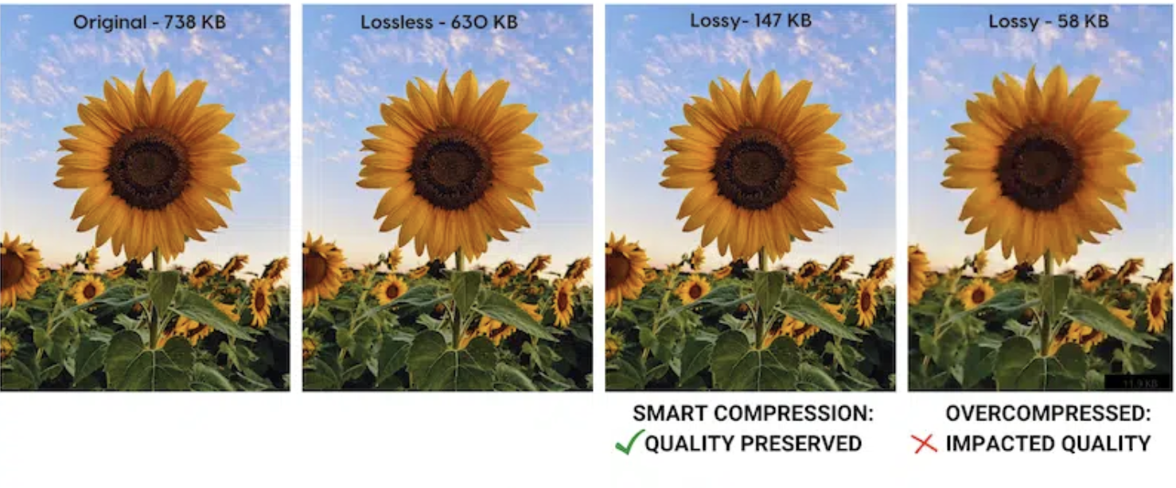
Lossy Compression
Compression can be divided into two kinds, lossless compression and lossy compression. Lossless compression can compress data without many information loss, while lossy compression sacrifice a little information loss but achieve higher compression ratio.
Quality control
High compression ratio
High throughput
Notes:
Before start talking about lossy compression challenge, I would like to talk about lossy and loss compression. [paragraph 1]
Here is an example of sunflower. JPEG-lossy, PNG-lossless The detail of cloud is lost.
This is why we apply lossy compression.

Slide 7
Challenge in Compression
How much data loss can be tolerated?
How many times can the data be compressed?
How quickly can data be compressed?
Data quality
Trade-off
Compression Ratio
Trade-off
Compression Throughput
Notes:
It is not straightforward approach to apply lossy compression naïve. There are some challenge in compression.
We must ensure the convergence of model training, if it cannot be granteed, lossy is meaning less how much acceleration can reach.
If compression is not high enough, we may decrease the end-to-end performance due to compression overhead,
If we can grantee the convergence, and find an algorithm provides high compression ratio, how to optimize it.
There are also trade-off between compressors and within compressor. [trade-off 1]

Slide 8
Challenge in Compression
How much data loss can be tolerated?
How many times can the data be compressed?
How quickly can data be compressed?
➔ Adaptive error bound adjustment
➔ New lossy compression algorithm for Embeddings
➔ GPU compression performance optimization
Data quality
Trade-off
Compression Ratio
Trade-off
Compression Throughput
Notes:
We propose three things to solve the challenges. 1,2,3

Slide 9
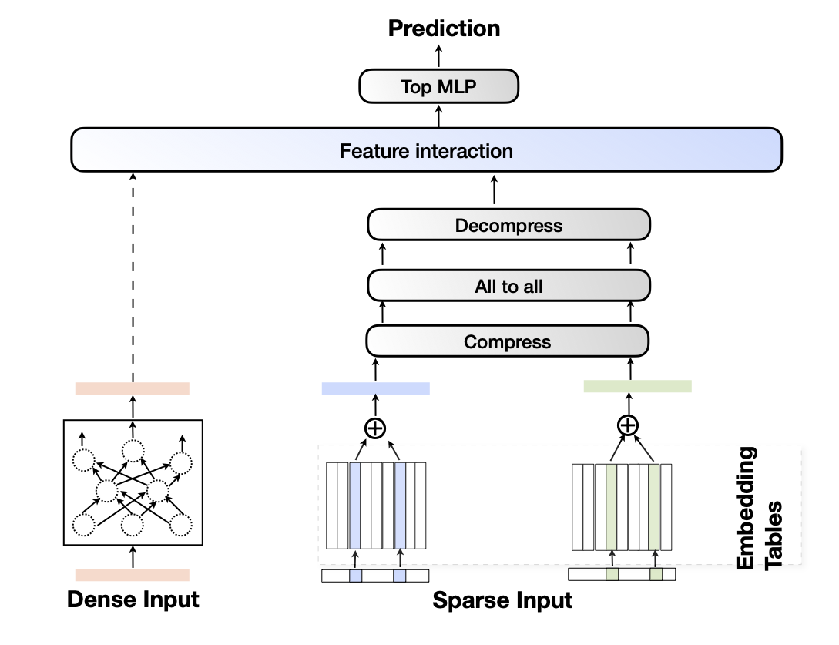
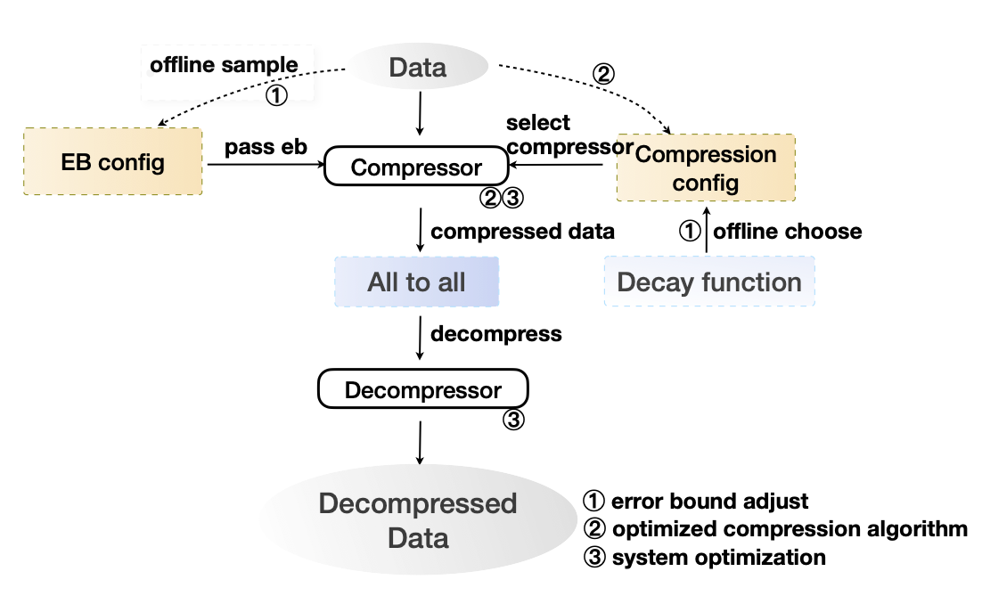
Our Contribution
Adaptive error bound adjustment: We proposed a two-level(Table-wise and Iteration-wise) error bound adjustment strategy to ensure the convergence of the model.
New lossy compression pipeline for EMB vectors: We proposed two new compression algorithms(LZ-based and Huffman-based) to increase compression ratio and performance on embedding data in DLRM.
GPU compression performance optimization: We first implement an optimized LZ algorithm for EMB vector data, and then apply Kernel fusion for higher throughput and minimizing data management costs.​
DLRM pipeline with lossy compression
Compression pipeline
Notes:
The top right figure shows the data flow pipeline, If we consider compression as a black box, our modification on DLRM is to add the comp/decomp, keep other unchanged.
The bottom right figure shows the compression pipeline, the circle number refers to what this part is releated to our contributions. Let us talk about our first contribution

Slide 10
Adaptive Error Bound Adjustment
Data quality
Trade-off
Compression Ratio
Trade-off
Compression Throughput

Slide 11
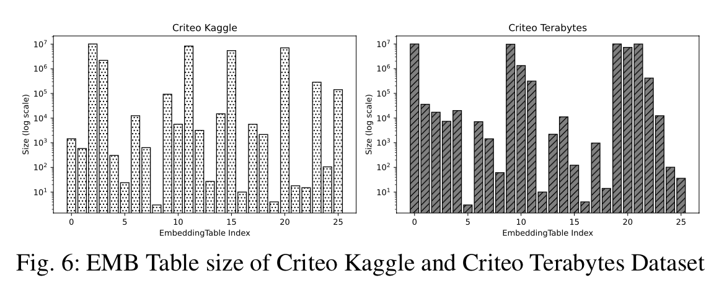
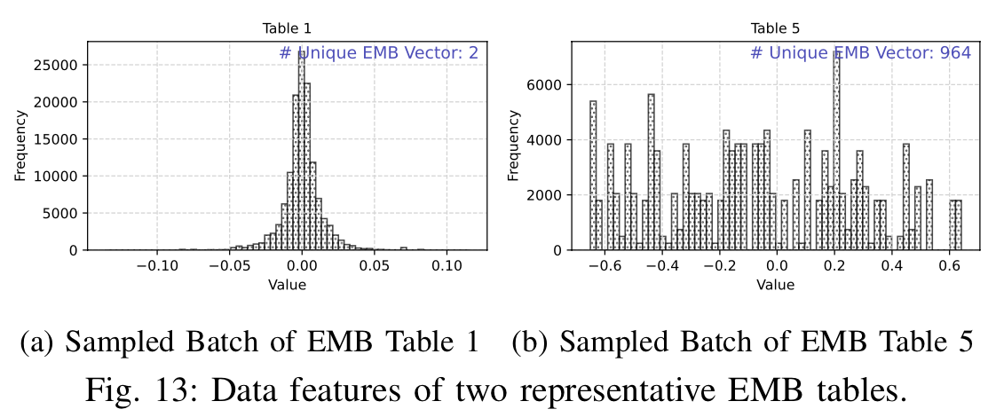
Adaptive Error Bound Adjustment
Table-wise Error Bound
Properties across different EMB tables are different, it is natural to apply different error bound strategies.
There are many data features. The key is what can we learn from that and how to choose error bound?
Error on compressed embeddings.
Notes:
Embedding table has different sizes and different distributions. same error bound does not fit all embedding tables. We divide the embedding tables into different classes with different error-bound configurations.
Let us deep dive into the data quality loss itself. We find some intersrting phenomenon

Slide 12
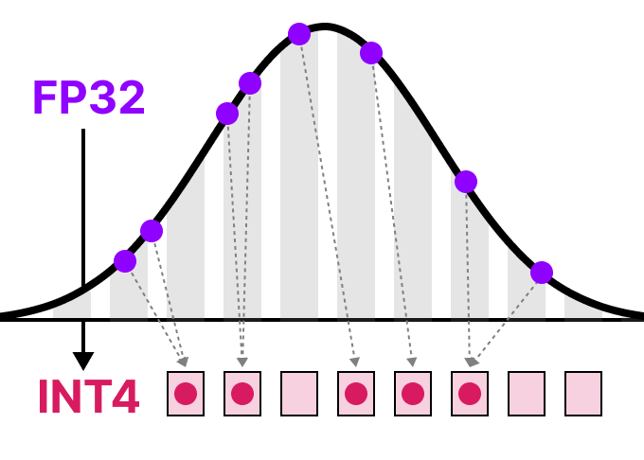
Adaptive Error Bound Adjustment
Where do we introduce error?
We can divide our compression pipeline into two parts: quantization parts and encoding parts.
Quantization involves precision loss and map values in a range to same bin. This is an irreversible transformation.
Notes:
We find some intersrting phenomenon
Embedding table has different sizes and different distributions. Embedding Vectors can be homogenized, same error bound does not fit all embedding tables. We divide the embedding tables into different classes with different error-bound configurations.

Slide 13
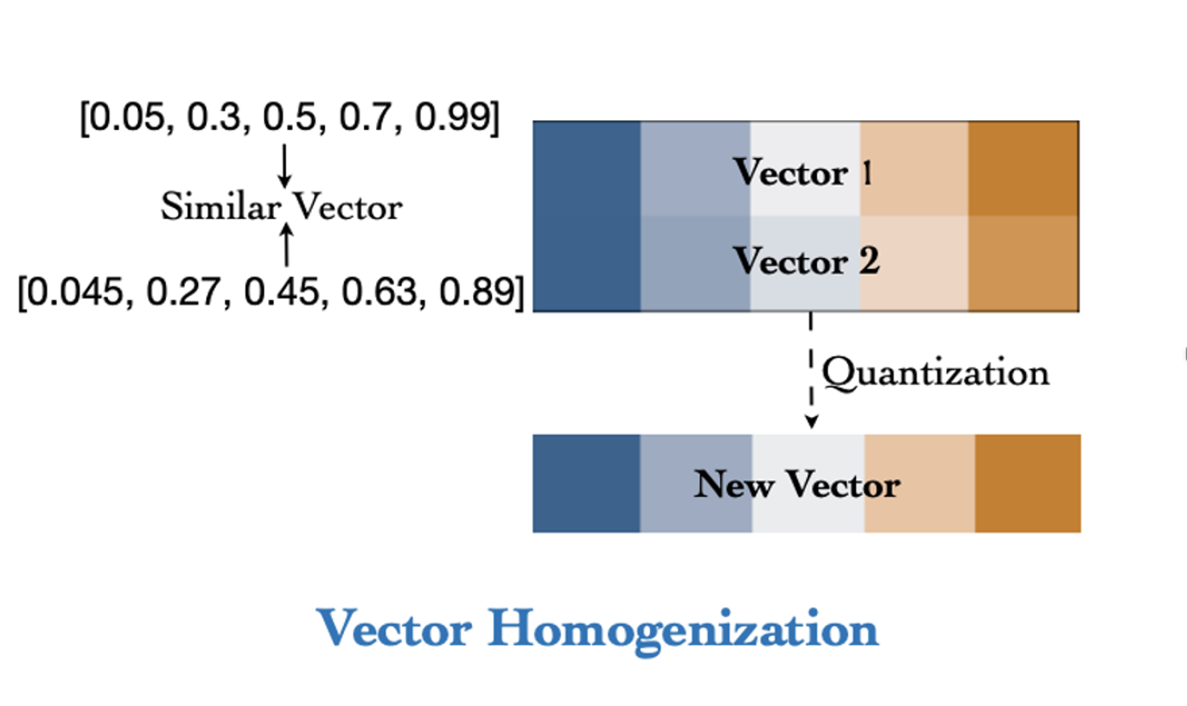
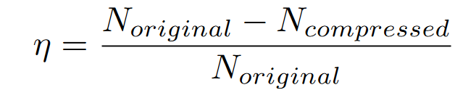
Adaptive Error Bound Adjustment
Vector Homogenization:
The impacts of quantization on EMB data from different tables are largely different, i.e., the number of unique quantized vectors is different for distinct tables.
We define Homo Index to measure the impact, the smaller the more intensive.
Homo Index Formula
Notes:
We choose homo index instead of mse or psnr because it has sematic meanings. It is not only introduce a noise, but It make embeddings confusing and indistinguishable. When we talk about a noise, we usually think of one vector transformed into 2 vector after adding noise, but The truth is exactly the opposite.

Slide 14
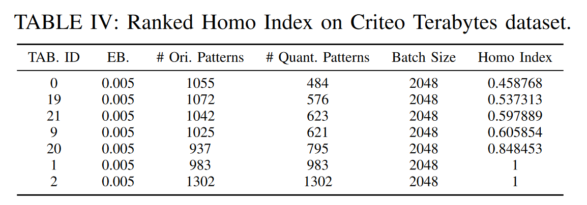
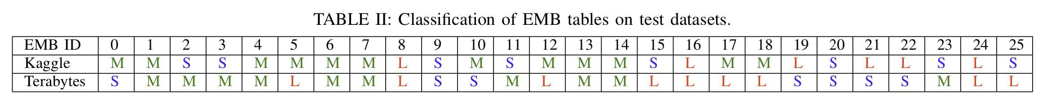
Adaptive Error Bound Adjustment
Table classification:
Sampling some batches of embeddings in training.
Ranking the Homo Indices of each embedding tables.
Divide them into multiple classes based on ranking.
Impact of Vector Homogenization
# Unique Vectors | Original | Quantized (eb=1e-2) | Quantized (eb=2e-3)
Table A | 59195 | 202 | 1305
Table B | 31277 | 31245 | 31277
Notes:
We do a table classification to apply table-wise error bound configuration. The lower homo index is , the error bound should be smaller.

Slide 15
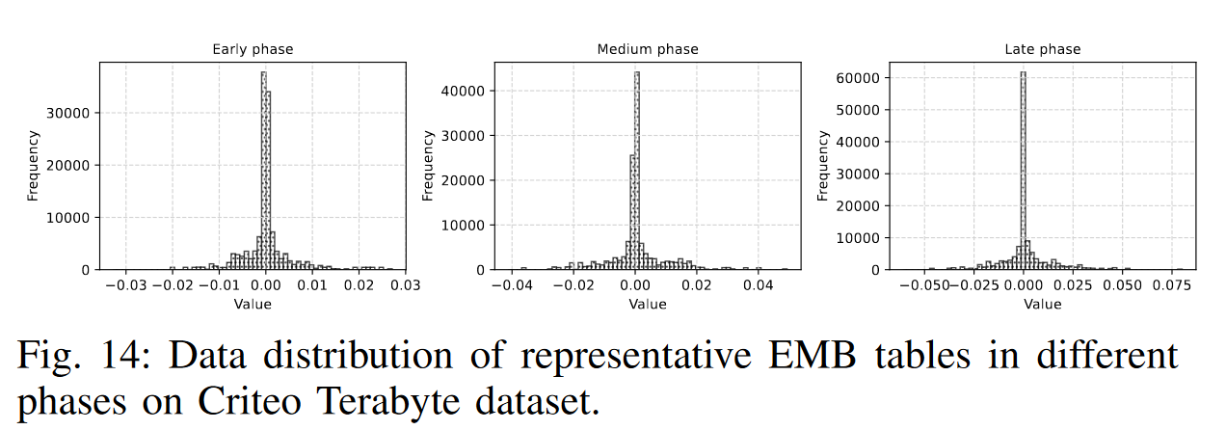
Adaptive Error Bound Adjustment
Iteration-wise Decay Strategy
We divide training into two phases: an initial phase(decay error bound), and a later phase(fixed error bound) to maximize error bound and compression ratio.
The final error bound = (decay factor) * (table-wise error bound)
Notes:
Can we always use large error bound? No, too large can leads to unconvergence.
In iterations, we inspired by learning decay. We apply error bound decay, we would like to

Slide 16
New Compression Pipeline
Data quality
Trade-off
Compression Ratio
Trade-off
Compression Throughput

Slide 17
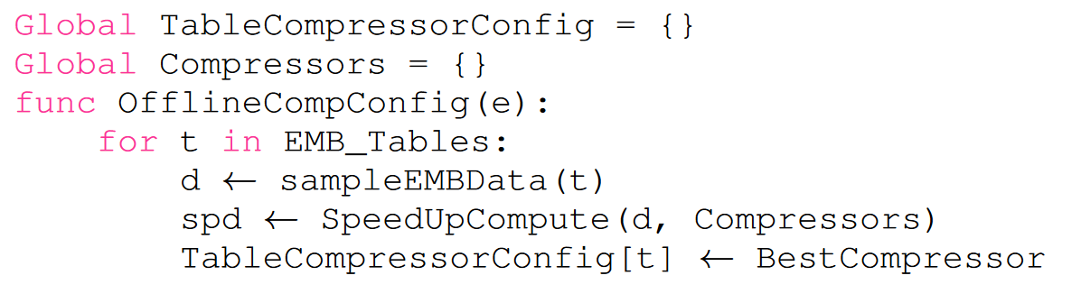
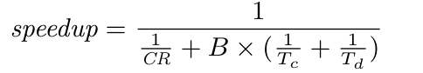
New Compression Pipeline
Step 1: Compressor Selection
Compressors have different compression ratio and throughput trade-off. The system specs are also various. Thus, there is not a perfect compression algorithm in all scenarios.
We sample some data in training to choose the best compressor for a given machine.
Data quality
Trade-off
Compression Ratio
Trade-off
Compression Throughput
Notes:
Let us recall the trade-off We estimate theoretical speed-up with the formula and then select the best compressor for each table with different hardware platforms.

Slide 18
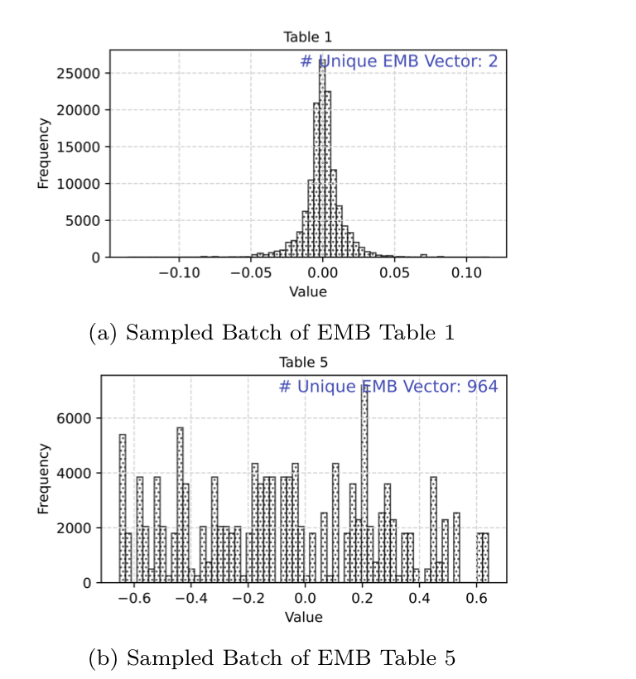
New Compression Pipeline
Step 2: Compress with optimized compression algorithm
Optimized Huffman Encoder
Designed for data with lower entropy and Gaussian distribution.
Optimize LZ Encoder
Designed for data with a lot of repeated patterns.
964
2
Notes:
Optimized Huffman Compressor
False Prediction would change lookup EMB data pattern, significantly causing lower compression ratio.
Optimize LZ Compression for EMB Vectors
The match pattern in lookup EMB data are multiple times of 64 bytes (i.e., the size of one EMB vector).
Modify our prior work on GPU-accelerated LZ compression to find the match pattern in the unit of vectors, which improves both compression ratio and compression throughput.

Slide 19
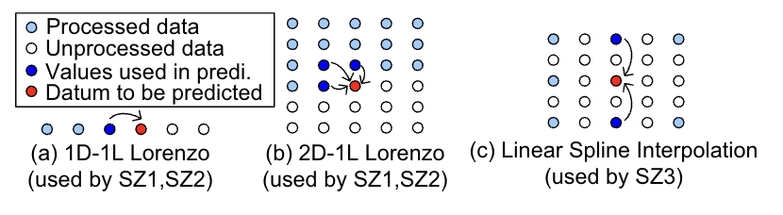
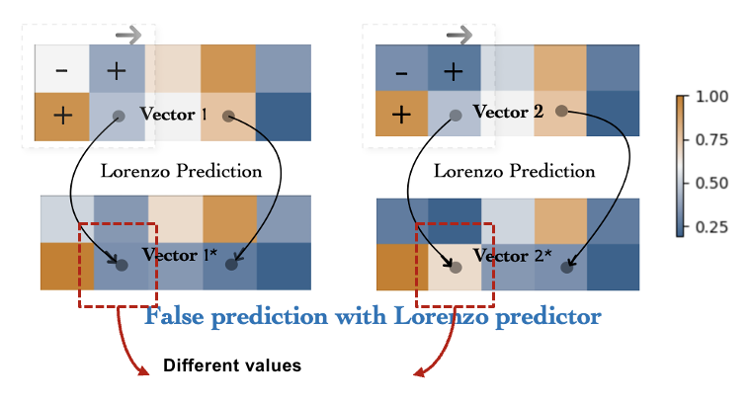
New Compression Pipeline
Huffman encoder: False Prediction
Prediction is a technique to estimate a value by its neighbors’ values. It can take advantage of spatial correlation.
However, in DLRM, not only does the EMB data have poor spatial correlation, but also the prediction can change the same lookup EMB data to a different one, significantly lowering the compression ratio.
Notes:
Let us first talked about a technique called prediction. It basically use the neibohor’s value to estimate the value of an element. It highly rely on correlation, for example, smooth dat

Slide 20
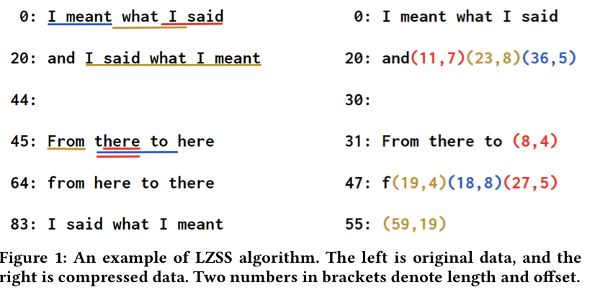
New Compression Pipeline
LZ encoder: Optimized pattern matching
LZ algorithm finds and references repeated data, replacing it with shorter indices to save space.
For embeddings, there are two kinds of repeated patterns: at the granularity of bytes/vectors.
Vector repetition contributes more to improving the compression ratio.
Notes:
The LZ (Lempel-Ziv) algorithm compresses data by identifying repeated patterns and replacing them with references to previously seen sequences. It builds a sliding window dictionary that dynamically records past data, and instead of storing duplicate strings, it uses shorter references consisting of an index and length. This effectively reduces redundancy and achieves compression.
Through the comprehensive utilization of the L1 cache, there is a discernible enhancement in performance, amounting to a 31.8% increase on the A100 and 118.1% on the A4000.
Concurrently, the compression ratio experiences a substantial elevation, amplifying by a factor of 5.23x.

Slide 21
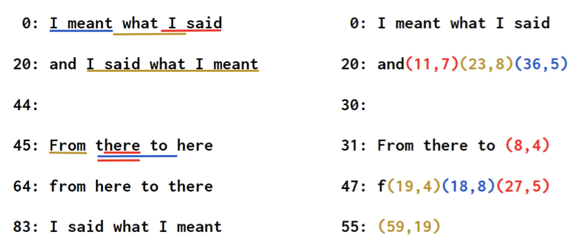
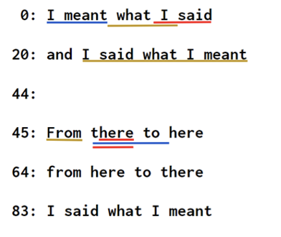
New Compression Pipeline
LZ encoder: Optimized pattern matching
The vector length is fixed, we can reduce the cost of sliding windows. Just match the pattern with a given length.
The vector length is large, we can have extremely high compression ratio.
Ignore repeated pattern at the granularity at bytes.
(0, 104)
Notes:
The LZ (Lempel-Ziv) algorithm compresses data by identifying repeated patterns and replacing them with references to previously seen sequences. It builds a sliding window dictionary that dynamically records past data, and instead of storing duplicate strings, it uses shorter references consisting of an index and length. This effectively reduces redundancy and achieves compression.
Through the comprehensive utilization of the L1 cache, there is a discernible enhancement in performance, amounting to a 31.8% increase on the A100 and 118.1% on the A4000.
Concurrently, the compression ratio experiences a substantial elevation, amplifying by a factor of 5.23x.

Slide 22
Compression Performance Optimization
Data quality
Trade-off
Compression Ratio
Trade-off
Compression Throughput

Slide 23
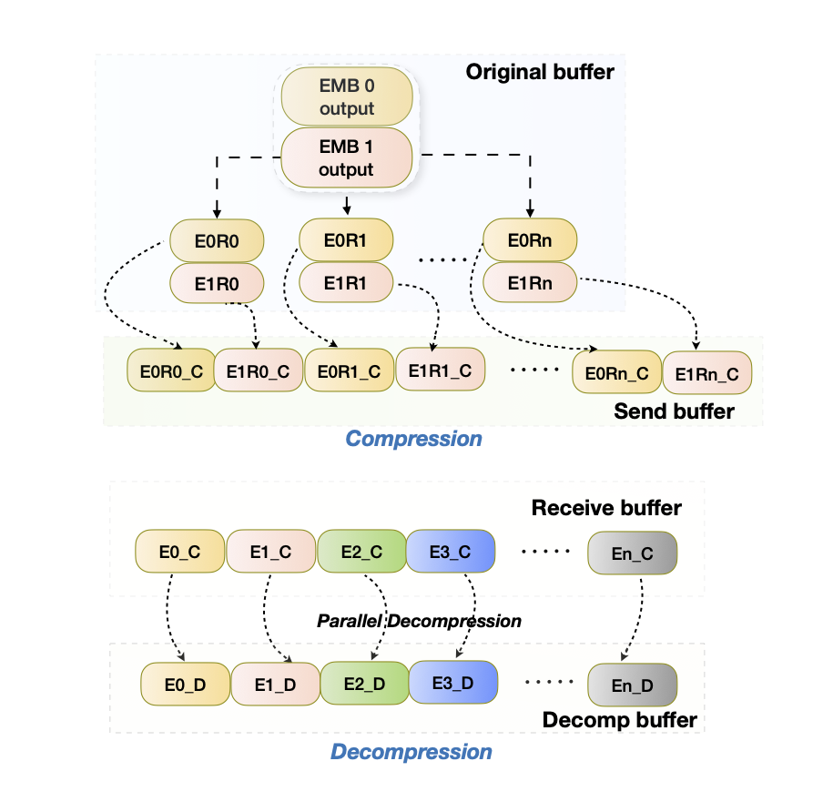
Compression Performance Optimization
Fused compression kernel launches
As the scale increases, the number of GPU in Alltoall communication group is also increasing. Introduce more segments for embedding split. The segments are usually too small to leverage the full utilization of GPU.
(De)Compress chunks in parallel to utilize GPU.
Remove the memory copy from the compressed buffer to the communication buffer.
Fused de/compression kernel
Notes:
The top right figure show the compression pipeline. We compress chunks simutenously and the write them into the correct offset directly. We only need to calculate the offset wit a small proportion of time.
The bottom right figure shows the parallel decompression. Decompression not only can be run parallel, but also get rid of the synchronization of offset compution.

Slide 24
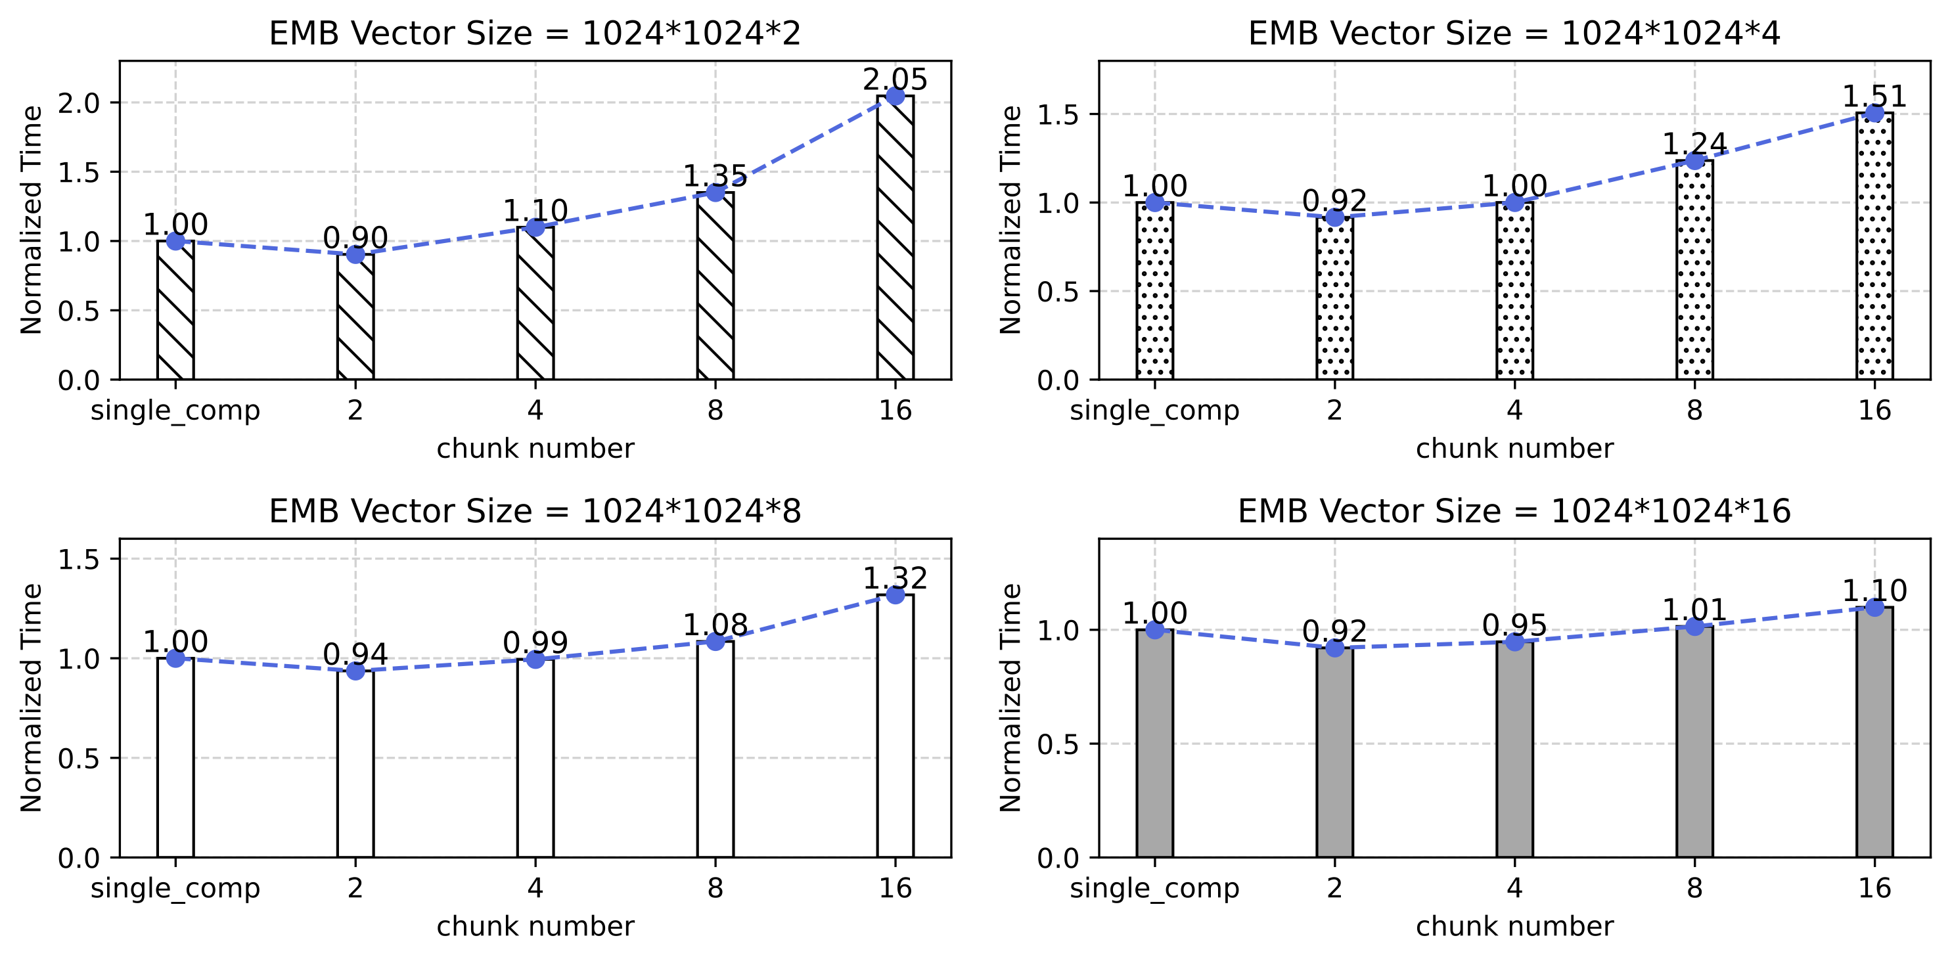
Compression Performance Optimization
Fused compression kernel launches
As a result, the performance increases by 30.3% on average. This approach shows more significant improvement when the data chunk size is small.
Fused de/compression kernel
Single_comp buffer optimization
Notes:
Here we can show the

Slide 25
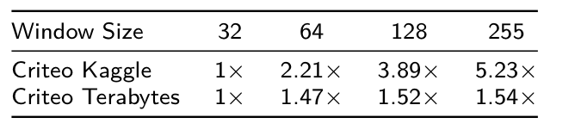
Compression Performance Optimization
LZ encoder: memory optimization and window size tuning
LZ encoder only match patterns within a window. Shared memory is used to store data in a window.
Embeddings take many bytes, require larger window size. Shared memory is not big enough and it affects the usage of the L1 cache.
Use global memory to support very large window size.
Notes:
The LZ (Lempel-Ziv) algorithm compresses data by identifying repeated patterns and replacing them with references to previously seen sequences. It builds a sliding window dictionary that dynamically records past data, and instead of storing duplicate strings, it uses shorter references consisting of an index and length. This effectively reduces redundancy and achieves compression.
L1 cache and shared memory share a memory space, one increase will lead to a decrease to the other. Through the comprehensive utilization of the L1 cache, there is a discernible enhancement in performance, amounting to a 31.8% increase on the A100 and 118.1% on the A4000.
A100 GPUs) shared memory capacity per SM is 164 KB,
Concurrently, the compression ratio experiences a substantial elevation, amplifying by a factor of 5.23x.

Slide 26
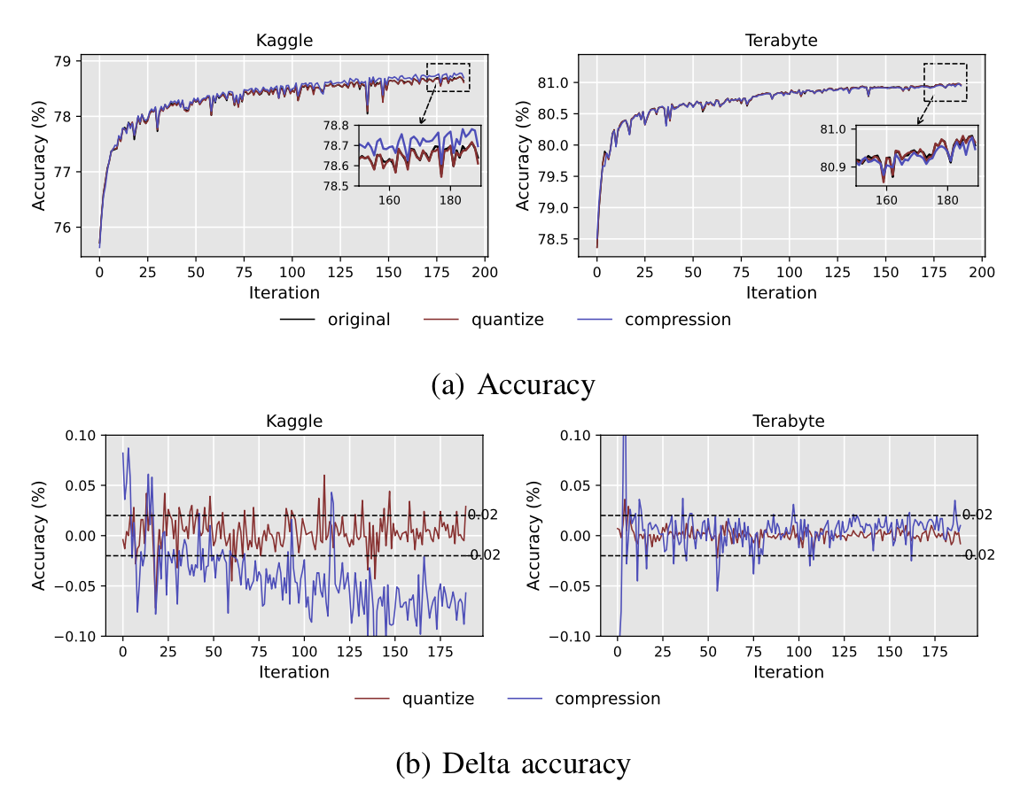
Accuracy of original DLRM vs Lossy Compression enabled DLRM
Accuracy Evaluation
We use Criteo Kaggle and Criteo Terabyte dataset in evaluation. Our evaluation platform is BigRed200. 8 GPU nodes each is equipped with 4 NVIDIA A100 GPUs.
On the two datasets we utilized, the average prediction accuracy losses are 0.0031% and 0.0042%, respectively.
Notes:
Dashline: baseline1 (fp32)
Yellow: baseline2 (fp16)
Gray: Ours / quantization (FP8)
cuSZ (eb=1e-2)
cuZFP (eb=5e-2)
The accuracy losses is totally acceptable.

Slide 27
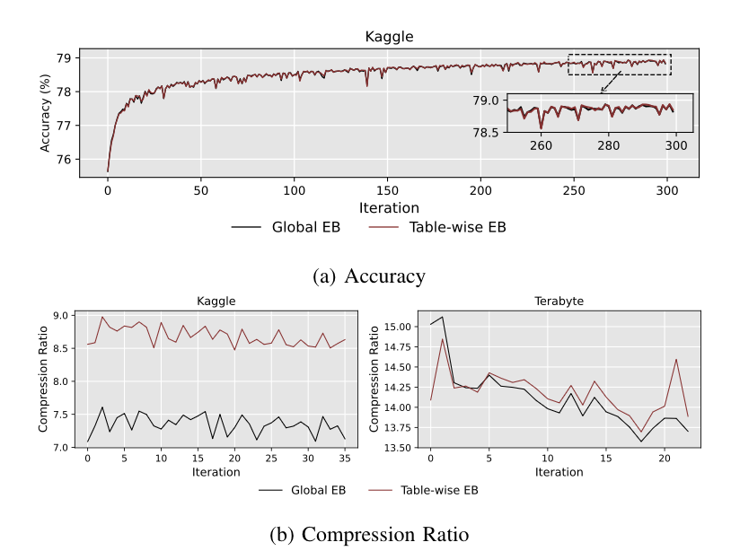
Accuracy Evaluation
With table-wise error bound design, we achieve up to 1.21x higher compression ratio.
Accuracy and compression ratio comparison of table-wise error bound vs global error bound
Notes:
After apply table-wise error bound selection, we can achieve higher compression ratio

Slide 28
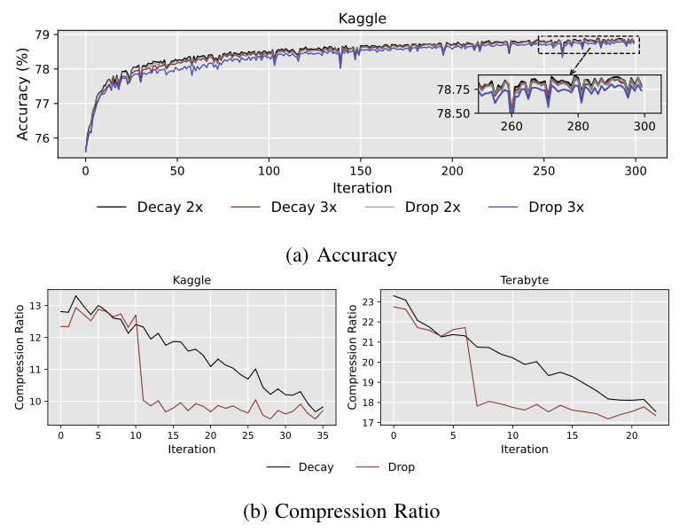
Accuracy Evaluation
With error bound decay strategy, we have a furthermore 1.09x higher compression ratio.
Accuracy and compression ratio comparison of decay error bound vs global static error bound
Notes:
Dashline: baseline1 (fp32)
Yellow: baseline2 (fp16)
Gray: Ours / quantization (FP8)
cuSZ (eb=1e-2)
cuZFP (eb=5e-2)

Slide 29
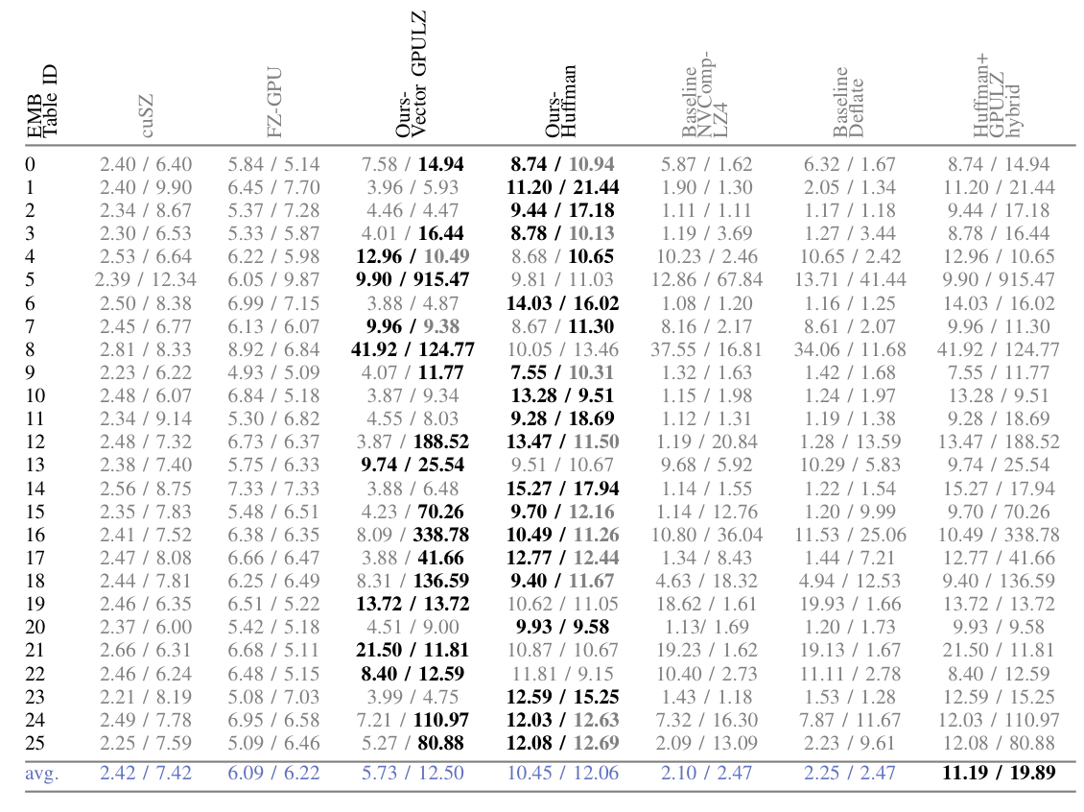
Platform: BigRed 200: https://kb.iu.edu/d/brcc
Performance Evaluation
Compression ratio
Our LZ encoder
Have extremely high compression ratio on some EMB tables.
Our Huffman encoder
Stable and high compression ratio.
Overall highest compression ratio at 11.19x and 19.89x
Compression ratio of different compressors on the two datasets (left: Criteo Kaggle, right: Terabytes). Bolded numbers indicate the highest compression ratios among compressors.
Notes:
cuSZ is like our Huffman encoder, but with the prediction
FZ-GPU use bitcomp as encoder, which has high throughput but relative low compression ratio
Deflate: lz77 + Huffman
It happens to complement the LZ method. Because of the
Comp ratio is from real data, comp throughput is from synthetic data
Problem: cuZFP CRs are variant, from less than 10GB/s to over 100GB/s
I use duplicate EMB vectors as input to measure the nvcomp lz4 throughput

Slide 30
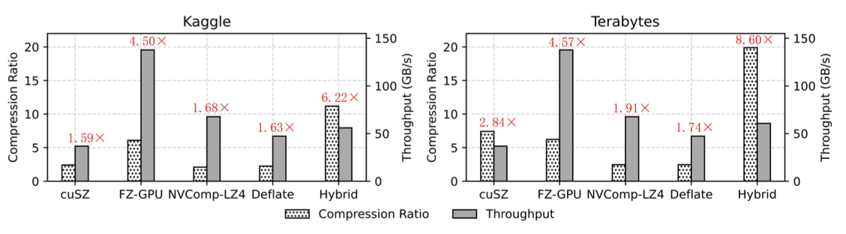
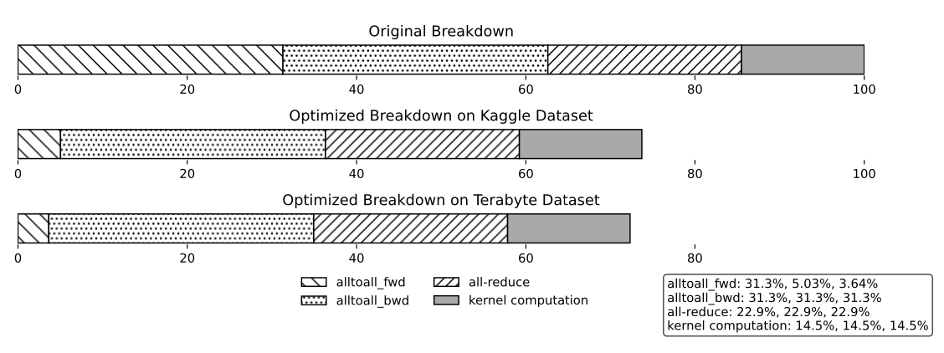
Platform: BigRed 200: https://kb.iu.edu/d/brcc
Performance Evaluation
Compression ratio, throughput, and communication speedup of different compression methods on different datasets. Batch size = 128 (Kaggle), 2048 (Terabytes).
Breakdown of optimized end-to-end DLRM training time on different DLRM datasets 1.30x and 1.38x for two datasets.
Notes:
. Alltoall_fwd is reduced from 31.3% to 3.64% in training.

Slide 31
Conclusion
To accelerate the communication in DLRM training, we propose three designs.
1. Adaptive error bound adjustment
2. New lossy compression pipeline for Embeddings
3. GPU compression performance optimization
We achieve up to 1.38x speedup in end-to-end training and 8.6x speedup in Alltoall communication with nearly no accuracy loss.

Slide 32
Thank you!
Questions?
Contact: haofeng@iu.edu
Github Link: https://github.com/allenfengjr/dlrm_comp

